Slide 1


Meysam Modiryan
1 June 2022

Slide 2

Outline
Executive Summary
Introduction
Methodology
Results
Conclusion
Appendix

Slide 3
Executive Summary
The Methodologies to Analyze Data
Collecting the data with web scraping by Request to the SpaceX API & Clean the requested data
Exploratory Data Analysis (EDA) by using SQL and VISUALIZATION
Interactive Visual Analytics and Dashboard
Machine Learning Prediction
Summary of all results
Collection data was possible from public source
By EDA we were able to figure out features’ dependency and identify the best features for prediction
And we understood which classification algorithm is better than the others to predict in machine learning prediction part.

Slide 4
Introduction
Project background and context
We predicted if the Falcon 9 first stage will land successfully. SpaceX advertises Falcon 9 rocket launches on its website, with a cost of 62 million dollars; other providers cost upward of 165 million dollars each, much of the savings is because SpaceX can reuse the first stage. Therefore, if we can determine if the first stage will land, we can determine the cost of a launch. This information can be used if an alternate company wants to bid against SpaceX for a rocket launch Problems you want to find answers
• Desirable answers:
* The best way to estimate the total cost for launches, by predicting successful landings of the first stage of rockets;
* Where is the best place to make launches.

Slide 5

Section 1

Slide 6
Methodology
Executive Summary
Data collection methodology:
Data was collected from two sources
Data collection API, actually Space X API (link)
Web Scraping (link)
Perform data wrangling
we performed some Exploratory Data Analysis (EDA) to find some patterns in the data and determined what would be the label for training supervised models.

Slide 7
Methodology
Executive Summary
Perform exploratory data analysis (EDA) using visualization and SQL
Perform interactive visual analytics using Folium and Plotly Dash
Perform predictive analysis using classification models
We Performed exploratory Data Analysis and determined Training Labels
create a column for the class
Standardize the data
Split into training data and test data
We found best Hyperparameter for SVM, Classification Trees and Logistic Regression and finally we found the method performs best using test data

Slide 8
Data Collection
Data sets were collected from:
Space X API
Wikipedia
The links of both are provided in previous slides
In the following, we will talk about these in detail

Slide 9
Data Collection – SpaceX API
we requested rocket launch data from SpaceX API and Checked the content of the response, after that we tried to discover some more relevant information for this project.
03
02
01
Dealing with Missing Values
Filter the data frame to only include Falcon9 launches
Request and parse the SpaceX launch data
Source Code
Click here

Slide 10
Data Collection - Scraping
Web scraping Falcon 9 and Falcon Heavy Launches Records from Wikipedia
we performed web scraping to collect Falcon 9 historical launch records from a Wikipedia
we Extracted a Falcon 9 launch records HTML table from Wikipedia
we parsed the table and converted it into a Pandas data frame
Extract all column/variable names from the HTML table header
03
02
Create a data frame by parsing the launch HTML tables
01
Click to Source code
Request the Falcon9 Launch Wiki page from its URL

Slide 11

Data Wrangling
some common orbit types are shown in the following plot
In this part, we performed some Exploratory Data Analysis (EDA) to find some patterns in the data and determined what would be the label for training supervised models.
Calculate the number of launches on each site
Calculate the number and occurrence of each orbit
Calculate the number and occurrence of mission outcome per orbit type
Create a landing outcome label from Outcome column
Source code: https://github.com/MeysamModiryan/Applied-Data-Science-Capstione/blob/main/labs-jupyter-spacex-Data%20wrangling.ipynb

Slide 12
EDA with Data Visualization
We applied the catplot() function to some features to figure out the relation between them, Also we used bar chart and line chart to understand some relations between some features. The features that we visualized, are comen in the following:
Flight Number and Launch Site
Payload and Launch Site
the relationship between success rate of each orbit type
Flight Number and Orbit type
Payload and Orbit type
the launch success yearly trend
Some charts are provided in the next slide
Source code: https://github.com/MeysamModiryan/Applied-Data-Science-Capstione/blob/main/jupyter-labs-eda-dataviz.ipynb

Slide 13
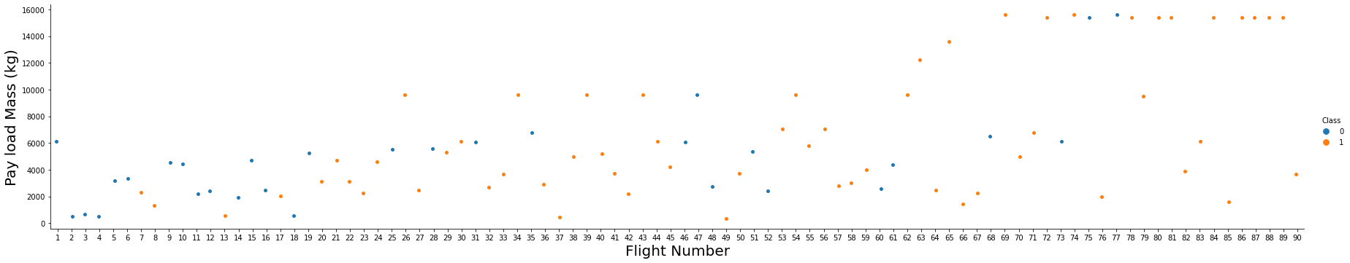
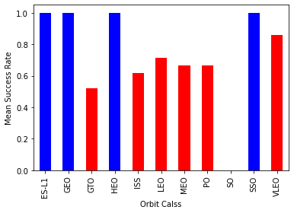
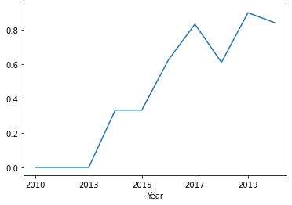
EDA with Data Visualization
success rate

Slide 14
EDA with SQL
summarize the SQL queries we performed
The names of the unique launch sites in the space mission
Top 5 records where launch sites begin with the string 'CCA’
The total payload mass carried by boosters launched by NASA (CRS)
Average payload mass carried by booster version F9 v1.1
the date when the first successful landing outcome in ground pad was achieved.
the names of the boosters which have success in drone ship and have payload mass greater than 4000 but less than 6000
the total number of successful and failure mission outcomes
the names of the booster versions which have carried the maximum payload mass. Use a subquery
the failed landing outcomes in drone ship, their booster versions, and launch site names for in year 2015
Rank the count of landing outcomes (such as Failure (drone ship) or Success (ground pad)) between the date 2010-06-04 and 2017-03-20, in descending order
Source code: https://github.com/MeysamModiryan/Applied-Data-Science-Capstione/blob/main/jupyter-labs-eda-sql-coursera.ipynb

Slide 15
Build an Interactive Map with Folium
In this part, we have performed more interactive visual analytics using Folium to complete the below tasks. By these, we should be able to find some geographical patterns about launch sites.
Mark all launch sites on a map
Mark the success/failed launches for each site on the map
Calculate the distances between a launch site to its proximities
we used some map objects in order to above tasks that they were:
Folium.Map(): To initial center location to be NASA Johnson Space Center at Houston, Texas.
Folium.Circle(): To add a highlighted circle area with a text label on a specific coordinate
Folium.map.Marker(): To Create a simple stock Leaflet marker on the map
MarkerCluster(): to simplify a map containing many markers having the same coordinate.
Folium.Marker(): To add objects to marker cluster. Also we used this to show the distance.
Folium.PolyLine(): To draw a line between a launch site to the selected coastline point.
Folium.Popup(): To Create a Popup instance that can be linked to a Layer.
And also we used the add_child() function to add objects that were created to the map.
Source code: https://github.com/MeysamModiryan/Applied-Data-Science-Capstione/blob/main/lab_jupyter_launch_site_location.ipynb

Slide 16
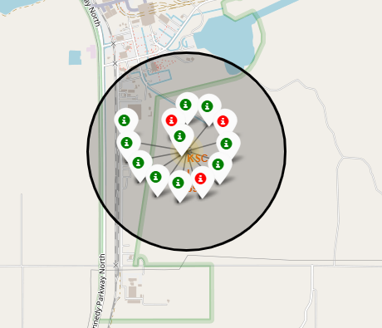
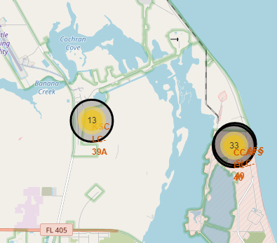
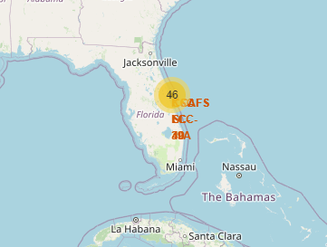
Build an Interactive Map with Folium
Some of the plots that we created are provided the below:

Slide 17
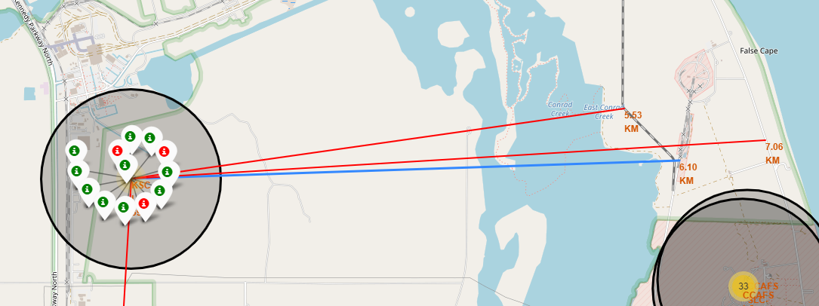
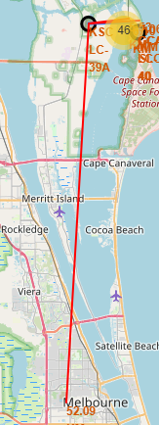
Build an Interactive Map with Folium
Some of the plots that we created are provided the below:
Line and distance between a launch site to its closest city, railway, highway, etc.

Slide 18
Build a Dashboard with Plotly Dash
We used:
Pie chart: To show the total percentage success launches for sites
Scatter Plot: To show the relation between Payload mass vs class
Also we used:
Dropdown: To filter or select a launch site on pie chart.
Rangeslider: To filter and change the range of Payload on Scatter plot.
This combination allowed to quickly analyze the relation between payloads and launch sites, helping to identify where is best place to launch according to payloads.
Source code: https://github.com/MeysamModiryan/Applied-Data-Science-Capstione/blob/main/spacex_dash_app1.py

Slide 19
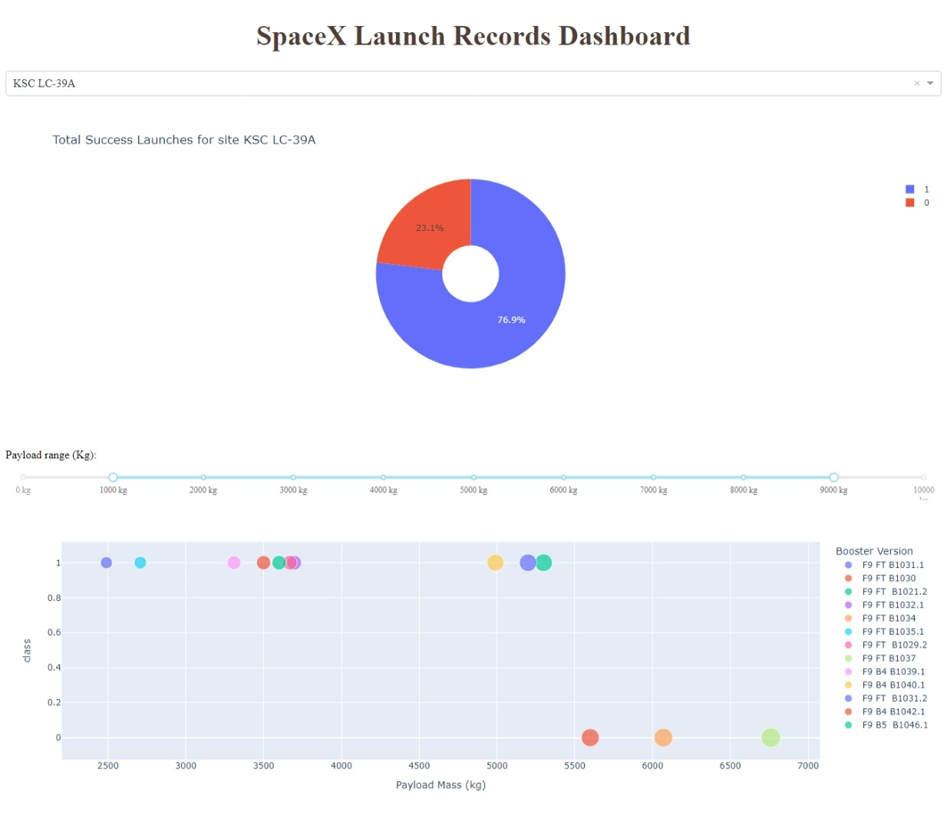
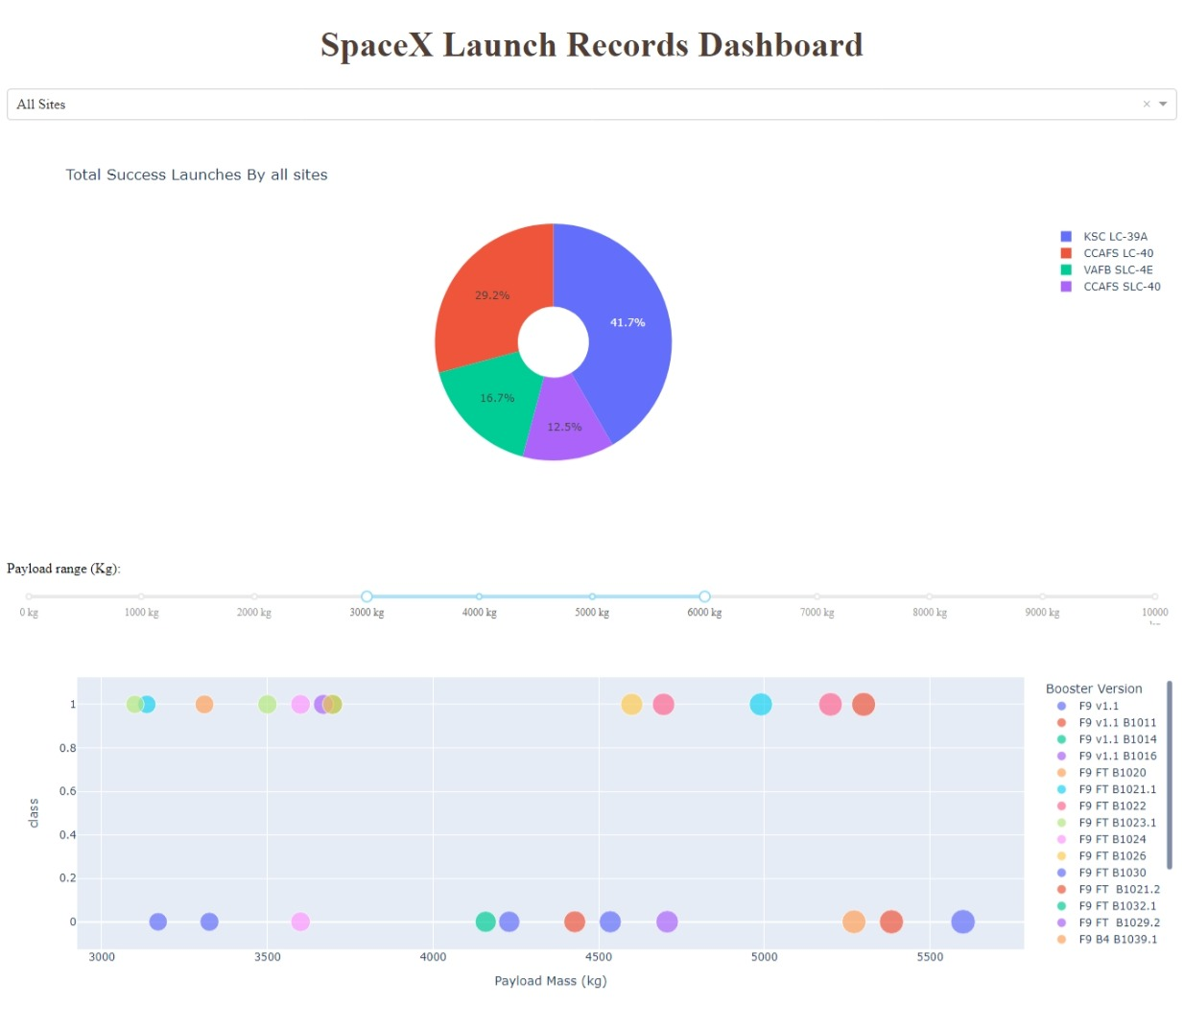


Build a Dashboard with Plotly Dash

Slide 20
Predictive Analysis (Classification)
After loading the dataframe, we created a NumPy array from the column class as the label and standardized X (features that were selected from previous) and split them into training and test data. We trained some classification models like LOGISTIC REGRESSION, SUPPORT VECTOR MACHINE, DECISION TREE, and K_NEAREST NEIGHBORS, and also we used GridysearchCV in order to find the best model parameters. after calculating the accuracy of each model (train and test set accuracy) we found the method performed best.
Source code: https://github.com/MeysamModiryan/Applied-Data-Science-Capstione/blob/main/SpaceX_Machine%20Learning%20Prediction_Part_5.ipynb
Data preparation
and
standardization
Test of each model
with combinations of
hyperparameters
Comparison of
results

Slide 21
Results
Exploratory data analysis results
Space X uses 4 different launch sites; (CCAFS LC-40, CCAFS SLC-40, KSC LC-39A, VAFB SLC-4E)
The first launches were done to Space X itself and NASA;
average payload mass carried by booster version F9 v1.1 is 2928 Kg.
2015-12-22 was the first successful landing outcome in-ground pad was achieved
Many Falcon 9 booster versions were successful at landing in drone ships having payload above the average;
Almost 100% of mission outcomes were successful;
Two booster versions failed at landing in drone ships in 2015: F9 v1.1 B1012 and F9 v1.1 B1015;
The number of landing outcomes became as better as years passed.

Slide 22
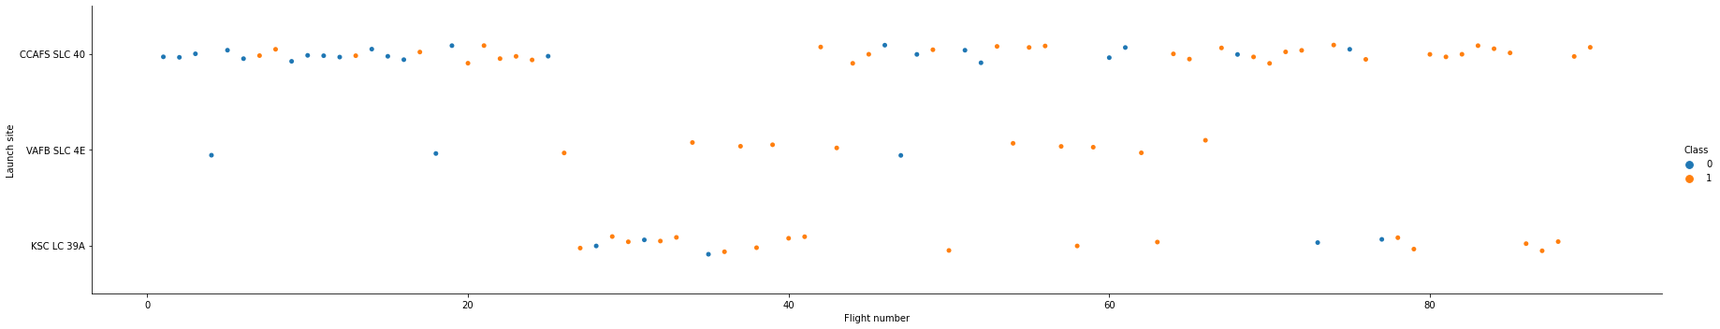
Results
Interactive analytics demo in screenshots (EDA with visualization)

Slide 23
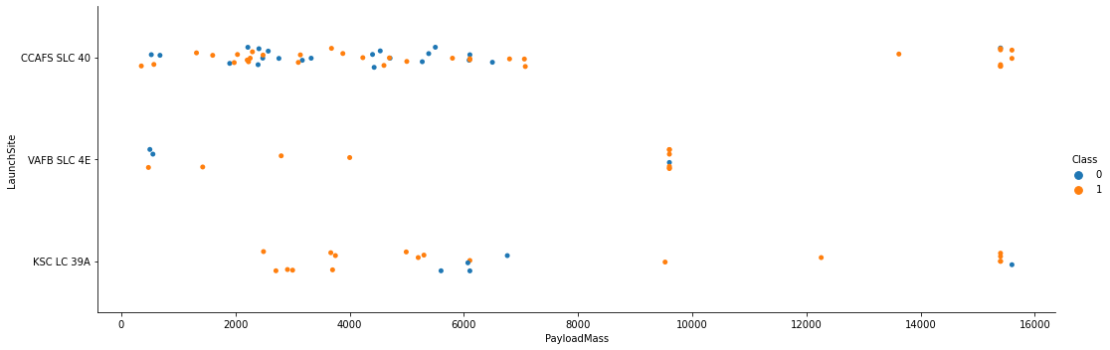
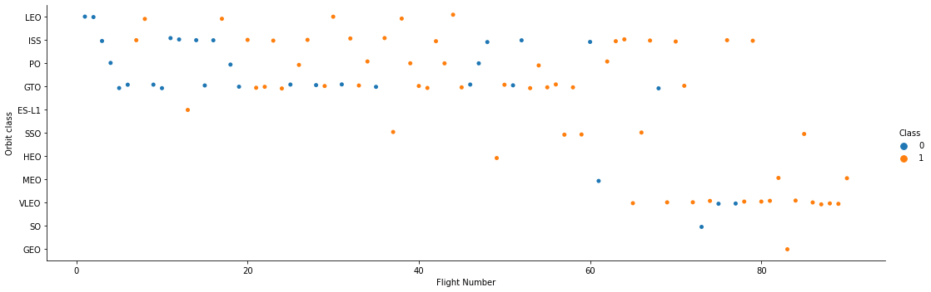
Results
Interactive analytics demo in screenshots (EDA with visualization)
success rate

Slide 24
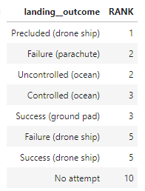
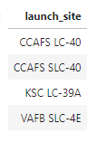
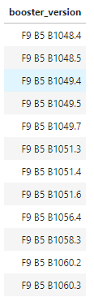
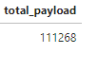
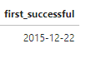
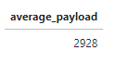
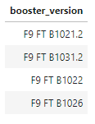
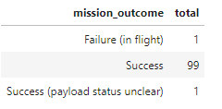
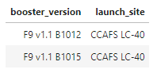
Results
the names of the booster versions which have carried the maximum payload mass
Interactive analytics demo in screenshots (EDA with SQL)
Rank the count of landing outcomes (such as Failure (drone ship) or Success (ground pad)) between the date 2010-06-04 and 2017-03-20, in descending order
the total payload mass carried by boosters launched by NASA (CRS)
average payload mass carried by booster version F9 v1.1
the date when the first successful landing outcome in ground pad was achieved.
the total number of successful and failure mission outcomes
the names of the boosters which have success in drone ship and have payload mass greater than 4000 but less than 6000
the failed landing outcomes in drone ship, their booster versions, and launch site names for in year 2015

Slide 25
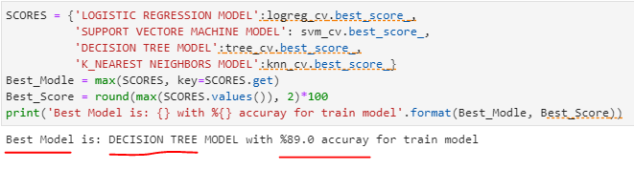
Results
Predictive analysis results
The Decision Tree classifier was the best model to predict a successful landing and had 89 percent accuracy for the training set and 84 percent for the test set.

Slide 26

Section 2

Slide 27
Flight Number vs. Launch Site
scatter plot of Flight Number vs. Launch Site
General success rate improved over the time;
According to the plot, the best launch site is CCAF5-SLC40 for nowadays;
Also, KSC LC 39A has a good success.

Slide 28
Payload vs. Launch Site
Scatter plot of Payload vs. Launch Site
Payloads over 8000kg have a excellent success rate;
KSC-LC39A site for payloads less than 5500kg has a good success rate;
it seems for WAFB-SLC4E site, payloads over 10000 are impossible.

Slide 29
Success Rate vs. Orbit Type
Bar chart for the success rate of each orbit type
ES-L1, GEO, HEO, AND SSO have the highest mean success rate and they are shown as blue bar charts
GTO has a lowest mean success rate between all orbits calls, about 50 percent.
ISS, LFO, MFO, AND PO have almost the same function. About 60 percent mean success rate;
VLEO class is not bad and its mean success rate is about 80 percent.
the classes with the lowest success rates are shown in red color in the chart.

Slide 30
Flight Number vs. Orbit Type
Scatter point of Flight number vs. Orbit type
Apparently, success rate improved over time to all orbits;
VLEO orbit seems a new business opportunity, due to recent increase of its frequency.

Slide 31
Payload vs. Orbit Type
Scatter point of payload vs. orbit type
it seems that in the LEO orbit the Success appears related to the number of flights; on the other hand, there seems to be no relationship between flight numbers when in GTO orbit.
There are few launches to the orbits SO and GEO.

Slide 32
Launch Success Yearly Trend
line chart of yearly average success rate
we can observe that the success rate since 2013 kept increasing till 2020, although it had a decreasing trend between 2017 and 2018, generally, it was ascending
success rate

Slide 33
All Launch Site Names
According to data, there are four launch sites
They are obtained by selecting unique occurrences of “launch_site” values from the dataset.
Launch site
CAFS LC-40
CCAFS SLC-40
KSC LC-39A
VAFB SLC-4E

Slide 34
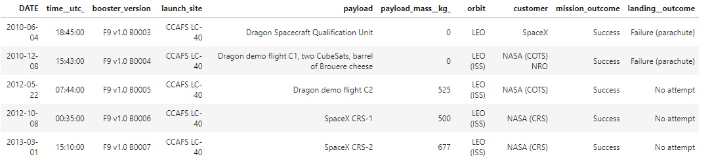
Launch Site Names Begin with 'CCA'
The 5 records where launch sites begin with `CCA`
Here we can see five samples of Cape Canaveral launches.

Slide 35
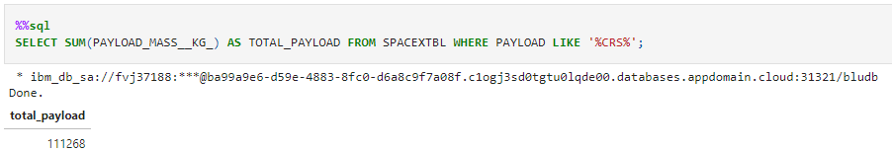
Total Payload Mass
the total payload carried by boosters from NASA
Total payload calculated above, by summing all payloads whose codes contain ‘CRS’, which corresponds to NASA.

Slide 36
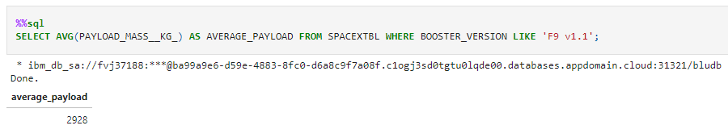
Average Payload Mass by F9 v1.1
The average payload mass carried by booster version F9 v1.1
Filtering data by the booster version above and calculating the average payload mass we obtained the value of 2,928 kg.

Slide 37
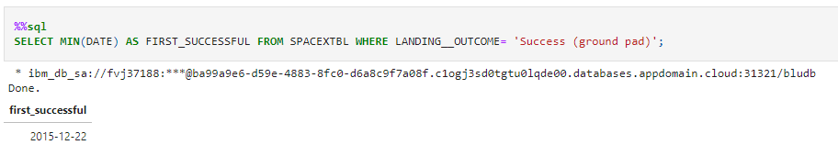
First Successful Ground Landing Date
the dates of the first successful landing outcome on ground pad
2015-12-22 was the first successful landing outcome in-ground pad was achieved

Slide 38
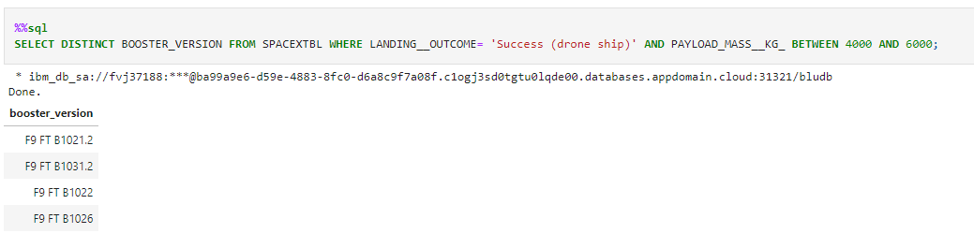
Successful Drone Ship Landing with Payload between 4000 and 6000
The names of boosters which have successfully landed on drone ship and had payload mass greater than 4000 but less than 6000
Selecting distinct booster versions according to the filters above, these 4 are the result.

Slide 39
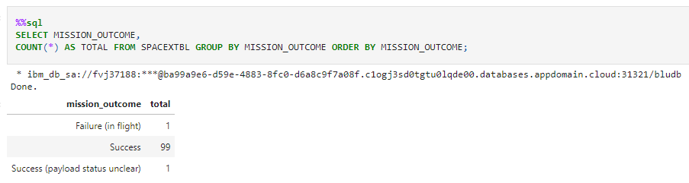
Total Number of Successful and Failure Mission Outcomes
The total number of successful and failure mission outcomes
Grouping mission outcomes and counting records for each group led us to the summary above.

Slide 40
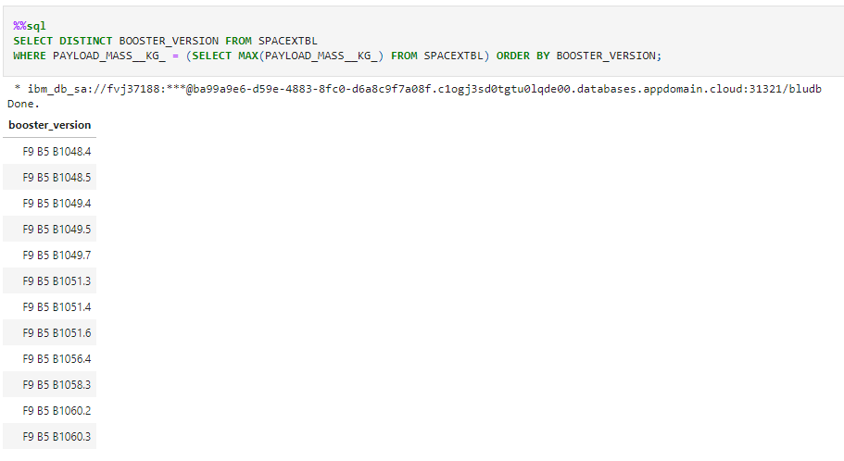
Boosters Carried Maximum Payload
The names of the booster which have carried the maximum payload mass
These are the boosters which have carried the maximum payload mass registered in the dataset.

Slide 41
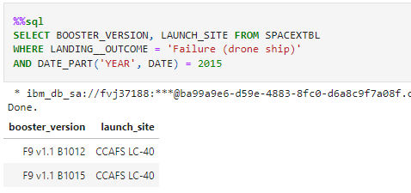
2015 Launch Records
The failed landing_outcomes in drone ship, their booster versions, and launch site names for in year 2015
The list has the only two occurrences.

Slide 42
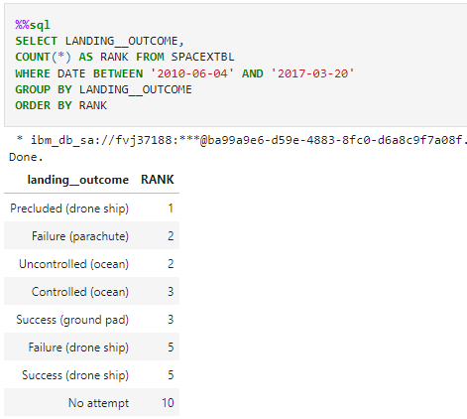
Rank Landing Outcomes Between 2010-06-04 and 2017-03-20
Rank the count of landing outcomes (such as Failure (drone ship) or Success (ground pad)) between the date 2010-06-04 and 2017-03-20, in descending order
This view of data alerts us that “No attempt” must be taken in account.

Slide 43

Section 3

Slide 44
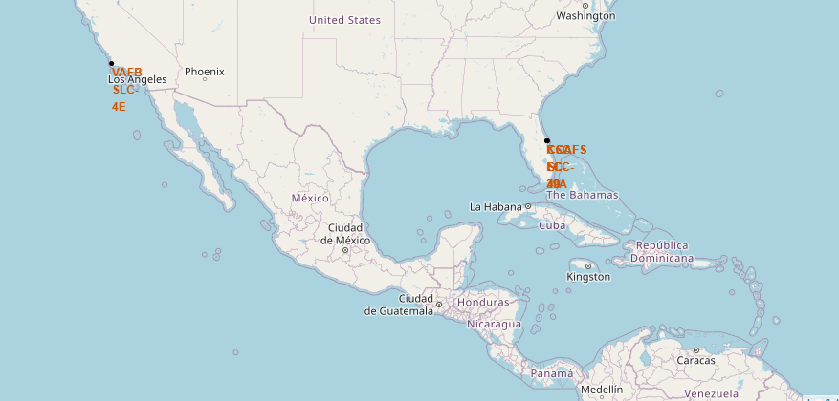
< All launch sites on a map >
we can see the locations of each site on the map and also they are so near to the sea and it seems for human safety located there.

Slide 45
< Launch Outcomes by Site >
Example of KSC LC-39A launch site launch outcomes

Slide 46
<Logistics and Safety>
Launch site KSC LC-39A has good logistics aspects, being near railroad and road and relatively far from inhabited areas.
Line and distance between a launch site to its closest city, railway, highway, etc.

Slide 47

Section 4

Slide 48
<Successful Launches by Site>
The place from where launches are done seems to be a very important factor of success of missions.

Slide 49
<The launch site with highest launch success ratio>
KSC-LC-39A has a highest success rate (about %77) between all launch sites.

Slide 50
<Payload vs. Launch Outcome scatter plot for all sites>
Payloads under 5500Kg and FT boosters are the most successful combination.

Slide 51

Section 5

Slide 52
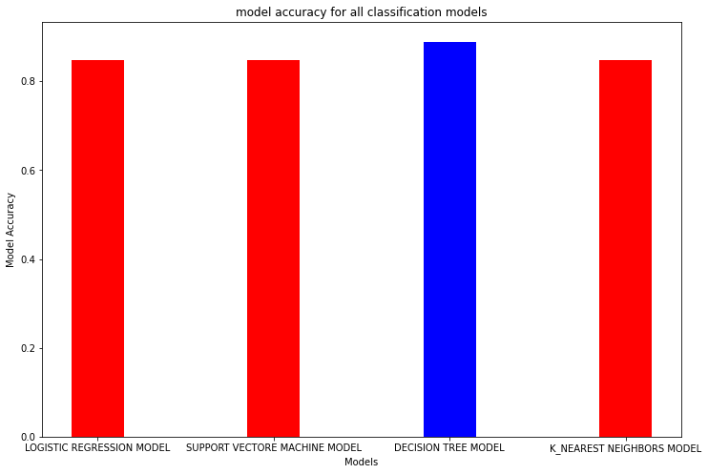
Classification Accuracy
All Classification models were trained and tested and their accuracy are plotted;
The model with the highest classification accuracy is Decision Tree Classifier, which has accuracies over than 87%.

Slide 53
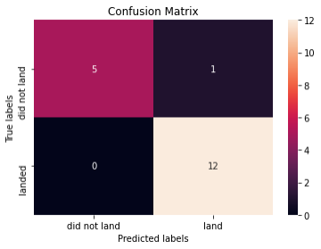
Confusion Matrix
Decision tree model has a good accuracy on test model and it has a excellent precision and recall.
Precision = 5 / (5+0) = 1
Recall = 5 / (5+1) = 0/833
F1Score = 0/907

Slide 54
Conclusions
Different data sources were analyzed, refining conclusions along the process;
We can see that KSC LC-39A had the most successful launches from all the sites
Orbit GEO, HEO, SSO, and ES-L1 have the best Success Rate
The success rates for SpaceX launches is directly proportional time in years they will eventually perfect the launches
For this data set Decision-Tree model has a better accuracy than other models

Slide 55
Appendix
All Appendix that we used in this project are provided on GitHub, and its link is provided below. Unfortunately, Folium didn’t show maps on GitHub and also Machine Learning Prediction isn’t run on GitHub too.
https://github.com/MeysamModiryan/Applied-Data-Science-Capstione.git

Slide 56


